Slide 1
Food and Beverage Management
The sixth edition
Chapter 9
Appraising Performance

Slide 2
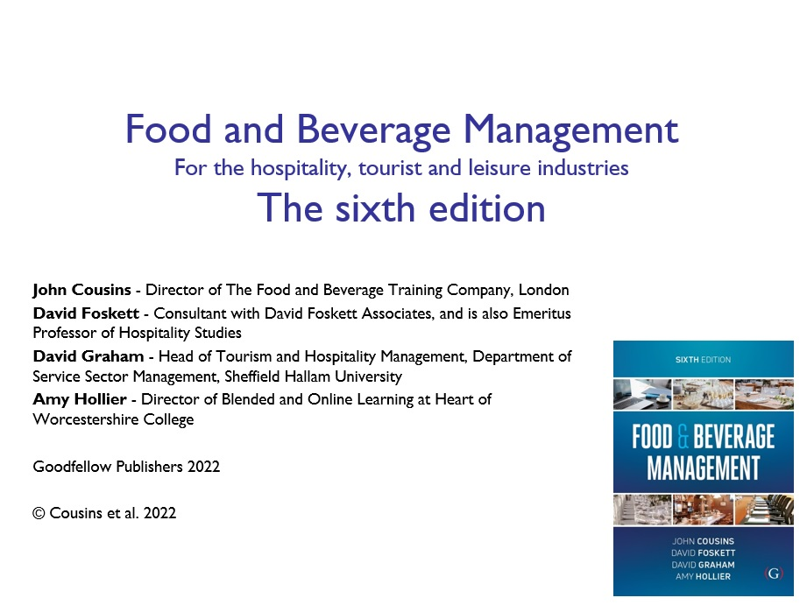

Slide 3
Chapter 9 covers:
Approaches to appraisal
Appraising revenue
Appraising costs
Appraising profits
Appraising the product

Slide 4
Performance appraisal
Revenue
Costs
Profits
The product

Slide 5
Fundamentals of appraisal
Knowing the aims and objectives of the operation
Placing a value on a measurement
Being prepared to make decisions

Slide 6
Basis of appraisal
Aims
Objectives
Budgets
Standards
  Aims are board intentions
  Objectives, budgets and standards are measurable against performance

Slide 7
Budget objectives
Are compared to actual performance to appraise outcomes, e.g. revenue budgets
Helps to:
  effect control over the operation, e.g. cost budgets
  predict the future, e.g. cash flow and profit forecast budgets

Slide 8
Performance against budget
Concept of variance calculation often misunderstood
Example:
  Budget revenue of £300 and a budget cash gross profit of £195 (65%)
  Actual revenue is £200 and the cash gross profit is £110 (55%)
  GP% change often wrongly reported as 10% drop in gross profit (65% less 55%)

Slide 9
Percentage variance on gross profit
Calculated as the difference between the actual cash gross profit and the budgeted cash gross profit, as a percentage of the budgeted cash gross profit
Calculated as:
  £110 – £195 ÷ £195 x 100
  This equals – 43.5%
  There has been a 43.5% drop in gross profit

Slide 10
Calculating variance on revenue
Calculated as the difference between the actual cash revenue and the budget revenue, as a percentage of the budget revenue
Budget revenue of £300, actual revenue £200
Calculated as:
  £200 – £300 ÷ £300 x 100
  This equals –33.3%
  There has been a 33.3% drop in revenue

Slide 11
Standards as measurable objectives
Examples of measurable standards: portioning, purchasing specifications, staff uniform, temperature, time
Standards are compared to actual performance e.g. portioning
Standards help effect control over specific parts of the operation, e.g. staff uniform and hygiene
Standards can contribute to ensuring a consistent product, e.g. the same service, meals and atmosphere, at all times, and in all locations

Slide 12
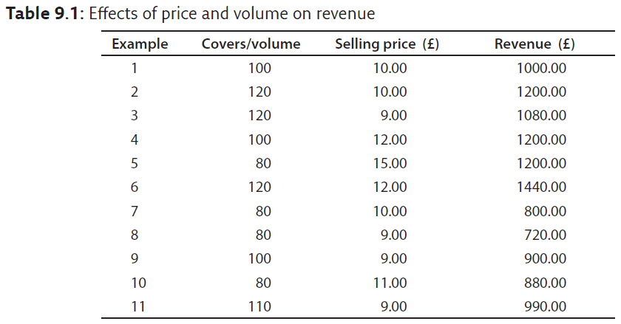
Price and volume on revenue

Slide 13
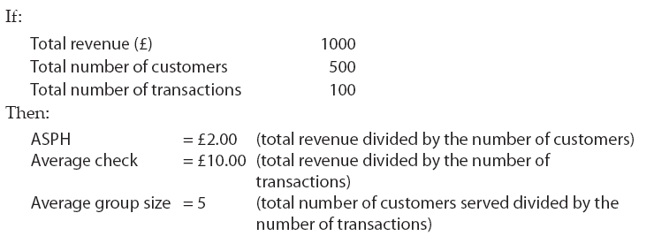
Spend per head and average check

Slide 14
Interpreting calculations
Price changes and inflation
Compare like with like
Comparison over time
Trends more clear with 12 month rolling totals
Averages can be very misleading
Other measures include:
  Cross-sectional analysis
  Time-series analysis

Slide 15
Key points of revenue appraisal
Revenue is product of price and volume
Appraisal needs to take account of changes in both price and volume
Averages not always accurate and prone to misinterpretation
Allow for inflation and/or price rises
Need to compare like with like
Incorporate 12-month rolling totals to determine true trends and performance
Revenue cannot be fully appraised by itself

Slide 16
Appraising costs
Fixed costs
Variable costs
Semi-variable costs

Slide 17
Identifying and measuring costs
Process needs to be objective
Can include:
  Cross-sectional analysis
  Relating one cost to another
  Time series analysis

Slide 18
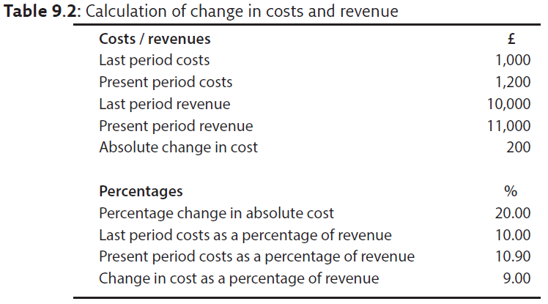
Change in costs and revenues

Slide 19
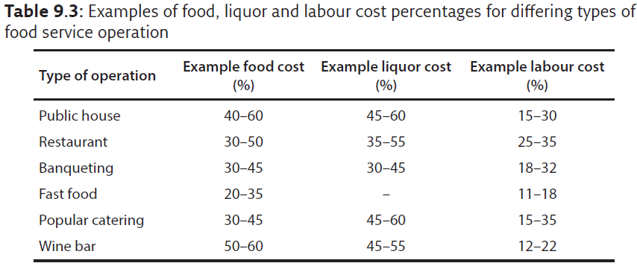
Industry norms for cost percentages

Slide 20
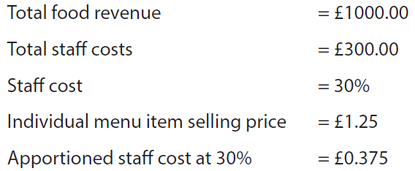
Apportioning direct costs

Slide 21
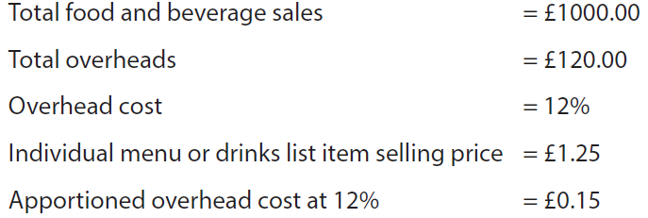
Apportioning indirect costs

Slide 22
Key points of cost appraisal
Structures vary, and change over time
Can be measured in cash or percentages, but important to interpret them differently
Proportional relationship between costs
Relationship between costs and inflation
Cross-sectional and time-series analyses useful
12-month rolling totals identify true performance
Operators with the lowest costs perceived as having a key advantage
Allocating indirect costs more complex than allocating direct costs

Slide 23
Profitability measures
Gross profit
Operating profit
Net profit
Net operating profit
Departmental and unit profit
Yield

Slide 24
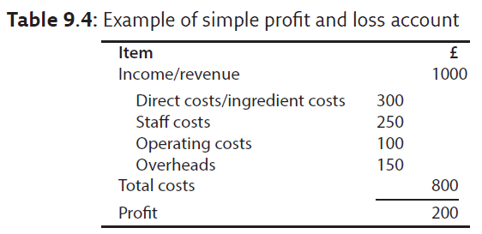
Example profit and loss account

Slide 25
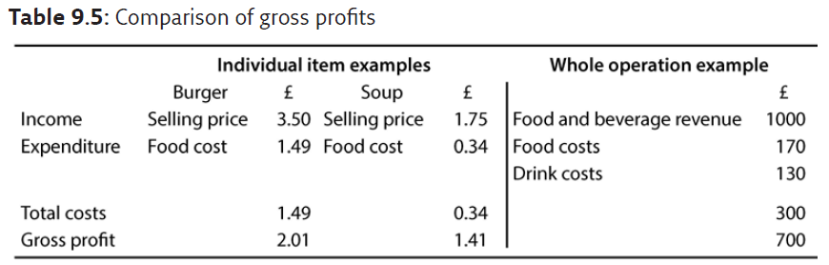
Comparison of gross profits

Slide 26
Gross profit percentage
The GP% of the burger example is 57.4%, the GP% for the soup is 80.6%, and the GP% for the operation is 70%
Food service operations use this measure extensively
A higher GP% does not always mean a higher cash GP
The soup has a higher GP% at 80.6% than the burger at 57.4%, but the soup is less profitable in absolute or cash terms, with a lower cash GP of £1.41 in comparison with the burger at £2.01

Slide 27
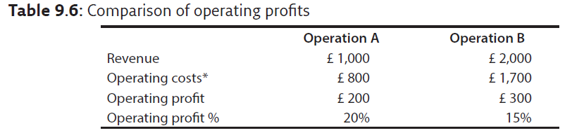
Comparison of operating profits
* Costs will include ingredient costs and staff cost. The extent to which other costs have been included needs to be established

Slide 28
Operating profit percentages
As with gross profit percentages, a higher operating profit percentage does not always mean a higher operating cash profit
Table 9.6 gives two examples:
  Operation A has a higher operating profit percentage at 20% than operation B at 15%
  Operation B has made a higher operating profit at £300 than operation A at £200

Slide 29
Calculating yield – beverage example
The selling price of each of the beverage items is multiplied by the units of that beverage item consumed
This yield is then measured as a percentage of the actual revenue

Slide 30
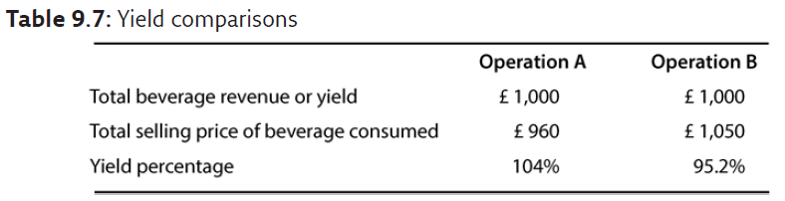
Yield comparisons – beverage example

Slide 31
Comparison of yield – beverage example
Operation A the yield was 104% This can happen because, for example:
  Drinks have been mixed, as in a cocktail
  Customers have been overcharged or short-changed.
  Wastage has not been as high as expected
Operation B the yield was 95.2%. This can happen because, for example:
  Wastage or ullage has occurred.
  Customers have been undercharged
  Measures have been miscalculated

Slide 32
In food service operations
Revenue (or sales) is always identified as 100%
Gross profit is total sales less cost of sales
Net profit is revenue less cost of sales, labour costs and overheads
Percentages for costs and profits are always stated as a percentage of sales

Slide 33
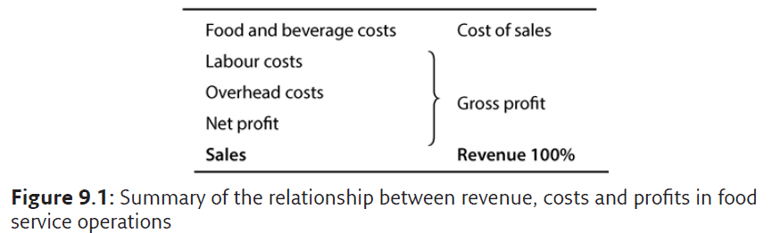
Revenue, costs and profits

Slide 34
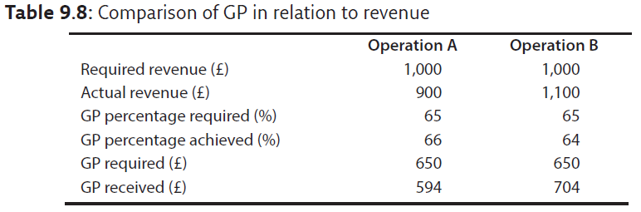
GP% in relation to revenue

Slide 35
GP% in relation to revenue
Operation A higher GP% than required at 66% but only achieves a cash GP of £594, £56 below that required
Operation B achieves a GP% below that which is required at 64% but achieves a cash GP of £704, £54 above that required
Operation A is more efficient than Operation B
But operation B is more profitable than Operation A

Slide 36
Tyranny of gross profit percentages
GP% seen as measure of control
Achievement of GP% often seen as more valuable than revenue
Percentages are a measure of efficiency not profitability
Percentages cannot be banked!

Slide 37
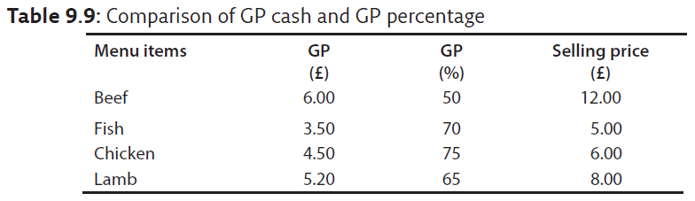
Comparison of cash GP and GP %

Slide 38
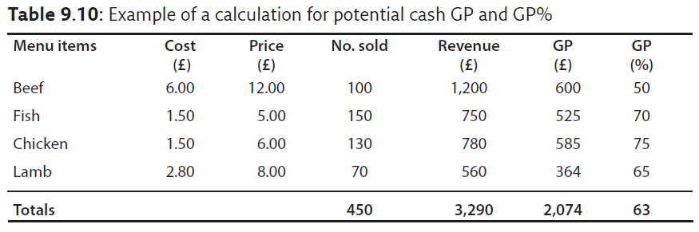
Potential cash GP and GP %

Slide 39
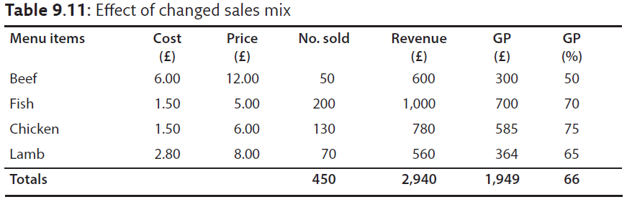
Effect of changed sales mix

Slide 40
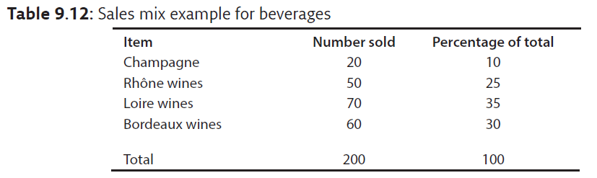
Sales mix example (beverages)

Slide 41
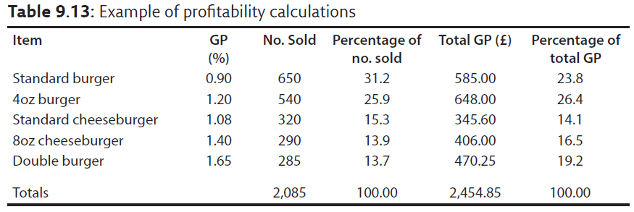
Example of profitability calculations

Slide 42
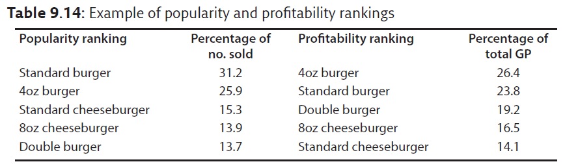
Popularity and profitability ranking

Slide 43
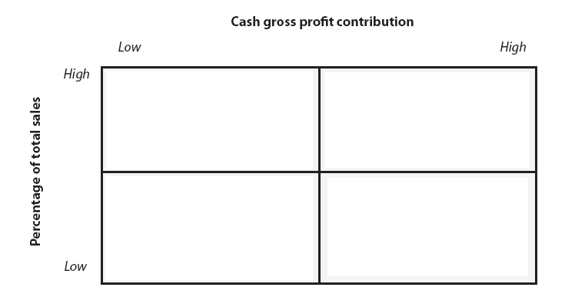
Menu engineering matrix
Adapted from Kasavana and Smith 1982

Slide 44
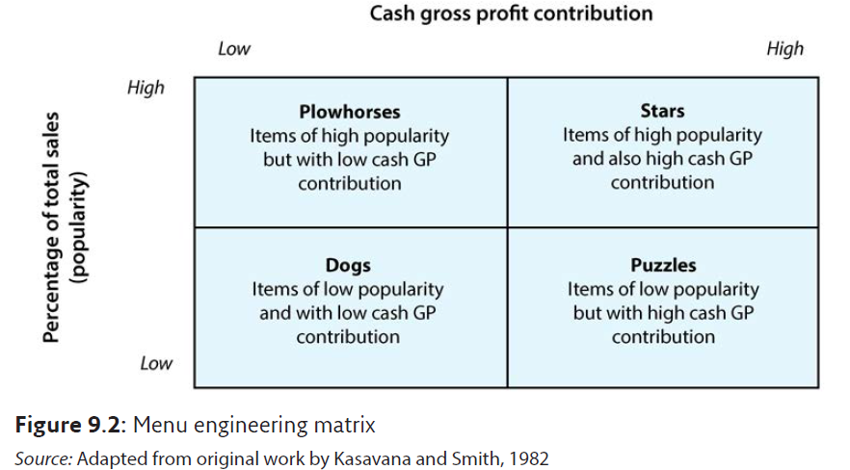
Menu engineering matrix

Slide 45
Helps to:
Plan for continuous control of cash GP
Identify and control the determinants of menu profitability
Treat different menu items uniquely
Can also be used for beverages, and is the basis for yield management for rooms division

Slide 46
Potential limitations
Elasticity of demand
Cost of labour
Shelf life
Fluctuations in demand

Slide 47
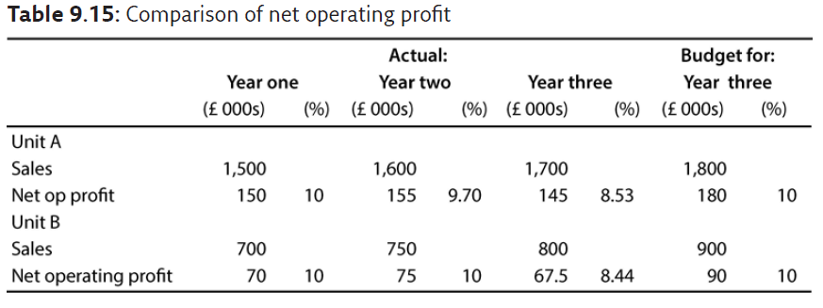
Comparison of net operating profit

Slide 48
Unit A performance
Sales have increased by £100,000 year-on-year. Percentage increase year-on-year of 6.67% and 6.25%, and overall, by 13.3%
Sales for year three are also up £100,000 but 5.55% under budget
Net operating profit increased 3.33% by £5,000 in the year two and decreased 6.45% by £10,000 in year three. Net operating for year three is £35,000 and 19.44% under budget
Net operating profit as a percentage of sales has declined from 10 to 9.7 to 8.53% compared with a required level in year three of 10%.

Slide 49
Unit B performance
Sales have increased by £50,000 year on year. A percentage increase of 7.14 and 6.67%, and overall, by 14.3%. Sales for year three are also up £50,000 but are 11.11% under budget
Net operating profit increased 7.14% by £5,000 in year two and decreased 10% by £7,500 in year three. Net operating profit for year three is also £22,500 down and 25% under budget. From year one to year three net operating profit declined by 3.57% (£70,000 to £67,500)
Net operating profit as a percentage of sales (10%) was maintained but has declined to 8.44% in year three

Slide 50
Additional considerations in profit appraisal:
Comparison with industry norms – but must compare like with like
The effects of inflation on prices
Stakeholder interests, including investors

Slide 51
Key points of profit appraisal
Be clear how profit measures are contrived
Compare like with like
Appraise against objectives to give value
Setting objectives includes subjective judgements
Sales mix analysis determines real trends
Profit percentages measure efficiency, not profitability
Cash contribution is what is being sought
Comparison with industry norms is valuable
Use rolling 12-month totals to indicate true performance
Take account of stakeholders’ priorities

Slide 52
Appraising the product
Approaches include:
  Measuring customer satisfaction
  Complaint monitoring
  Staff focus groups
  Mystery shopper
  Process reviews
  Quality audits
  Quality standards analysis

Slide 53
Using the data generated
Outcomes are often presented in quantitative form
Better use of the data can provide more qualitative analysis and better understanding of the operation
Information can be generated on what is important to the customer, how the operation is achieving or capable of achiev­ing those things, and if the staff share the same view
Based on the ‘SERVQUAL’ approaches, the data can be appraised and extended into examples of useful comparison matrices

Slide 54
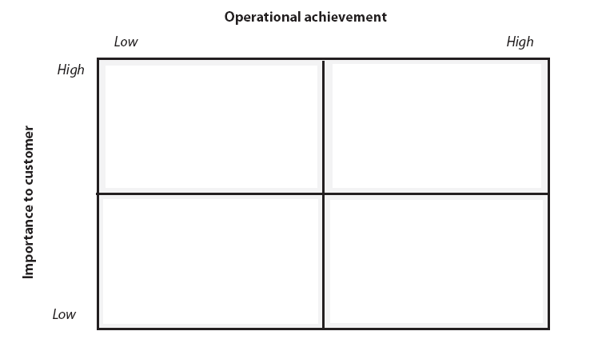
Customer importance / operational achievement matrix

Slide 55
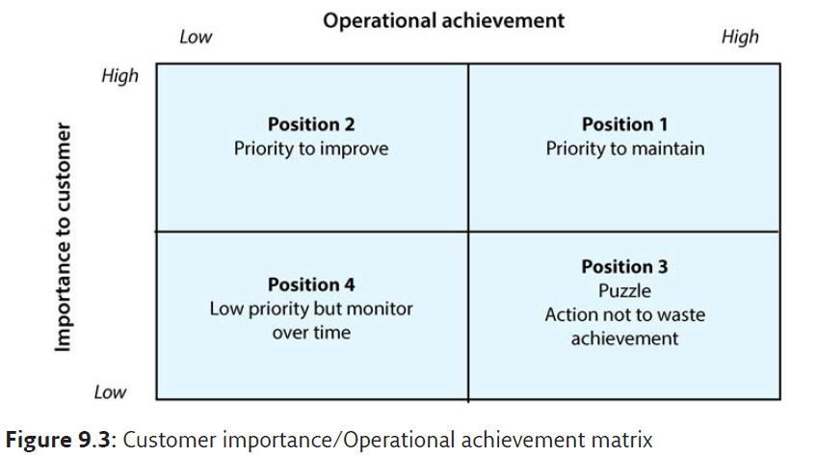
Customer importance / operational achievement matrix

Slide 56
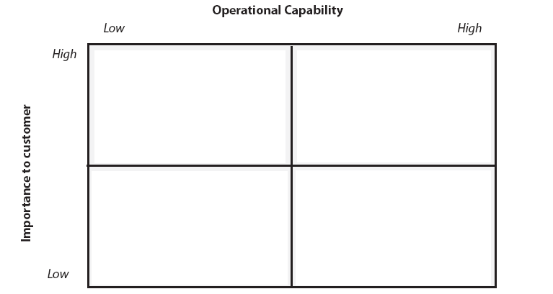
Customer importance / operational capability matrix

Slide 57
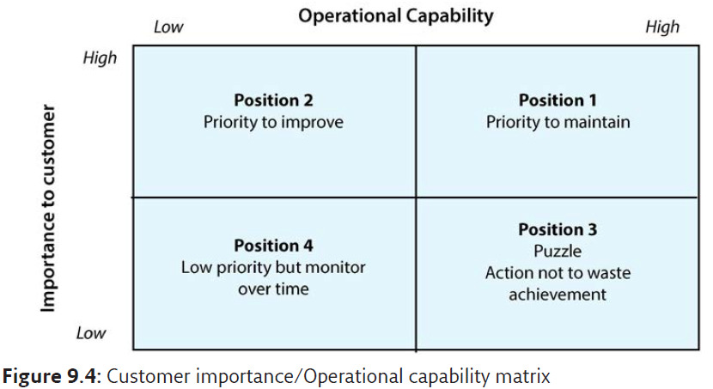
Customer importance / operational capability matrix

Slide 58
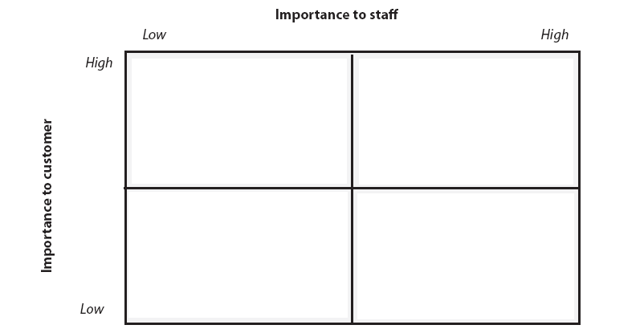
Customer importance / staff importance matrix

Slide 59
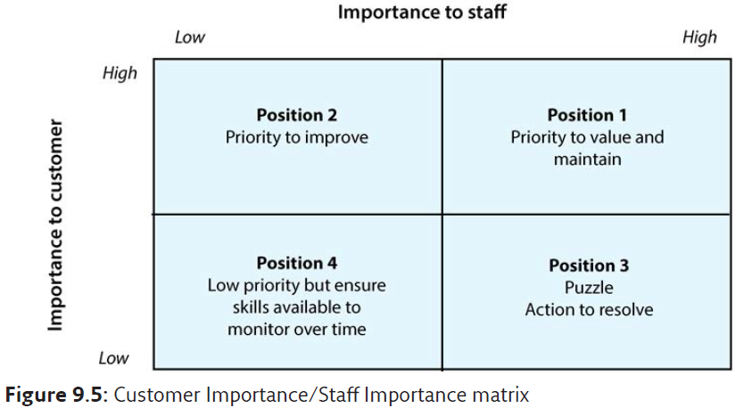
Customer importance / staff importance matrix

